Slide 1
Team Chilli
Notes:
Create Home Page
Insert Logo
Animations

Slide 2

Creative Hot Intelligent Little Large Ideas

Slide 3

Calvin Reed
Mthobisi Kunene
Warren Edy
Duran Moodley
Sachin Moodley
Andrea Mersatis
Notes:
Edit Image – (Our Team)
Order:
Calvin
Mtho
Warren
Duran
Sachin
Andrea

Slide 4

Contents
Problem Statement
Business Solution
Solution Domain
Milestones and Deliverables
Work Breakdown Structure
Budget
Database
GUI
Demonstration
Notes:
Animate

Slide 5

Problem Statement
THE CLIENT AND THEIR NEEDS
To provide a cheaper/free option to web hosting and database management.
Offered an alternative media with the android application for the Baby House
Added a Blog to the website and android app.
Provide reports for donators ,volunteers, staff, etc…

Slide 6
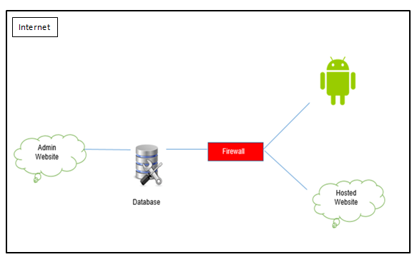
Business Solution
High-Level Architecture

Slide 7
Low-Level Architecture

Slide 8
Solution Domain
2.1 Participant (Active Actors) | 2.2 Functions | 2.3 Participant (Passive Actors)
Manager(Sheila) | Has access to the entire system (Backend and front).She has the final say to all processes.
Volunteer | Renders their services to the Baby House organization. Their details are entered into the system by Manager. Volunteers use the app to enter their check in and check out times | Manager
Manager (Sheila) | Produces a report for volunteers.
Adopters | Adoptee goes through a process to adopt a baby, this process will include interviews and background checks. | Manager
Donator | Donates money or items according to the wish list. | Manager
Manager(Sheila) | Prepares reports for donations and enters details about the donor.
Public user | Adds a post to the blog(Website or android) | Manager
Manager(Sheila) | Inspects post entered by the user for approval to post on the public website or android.

Slide 9
Milestones and deliverables
Milestones
Find NGO
Complete Project Plan
Complete Requirements Analysis
Complete System Design
Design the Database
Get the GUI design (Android App, Website, Admin Site) approved by client
Develop the website(Back End and Front End)
Develop the Android application
Testing Complete
Help files Constructed
Handover Project
Deliverables
Established La Lucia Baby House as NGO
Project Plan
Requirements Analysis
System Design
Running Database
GUI for Android App, Website, Admin Site
Admin Site
Website
Android App
Tested Software
Help Files

Slide 10
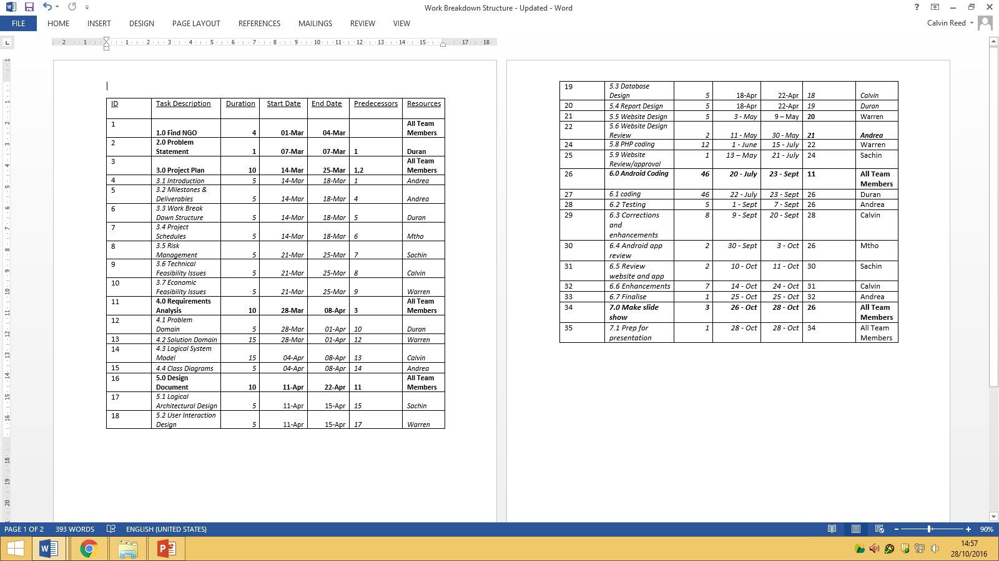
Work Break Down Structure

Slide 11
Budgets
Cost Constraints
The Baby House is an NGO therefore we as Team Chilli will be funding the project in kind as a form of donation. A project of this calibre would hold a cost to company of: R128 210. Hence, our team hopes that the project adds tremendous value to the Baby House and is used.

Slide 12
Database

Slide 13
Scope
There are 10 tables in our database:
People
Baby
Volunteers
Staff
Donators
Adopters
Events
Blog
Wish list
Volunteer attendance

Slide 14
Relationships
Table Name | Primary Key (PK) | Foreign Key (FK)
People | personID
Baby | babyID | personID
Volunteers | volunteerID | personID
Volunteer Attendance | vaID | volunteerID
Staff | staffID | personID
Donators | donorID | personID
Adopters | adoptersID | personID
Events | eventID
Blog | blogID
Wish List | wishID

Slide 15
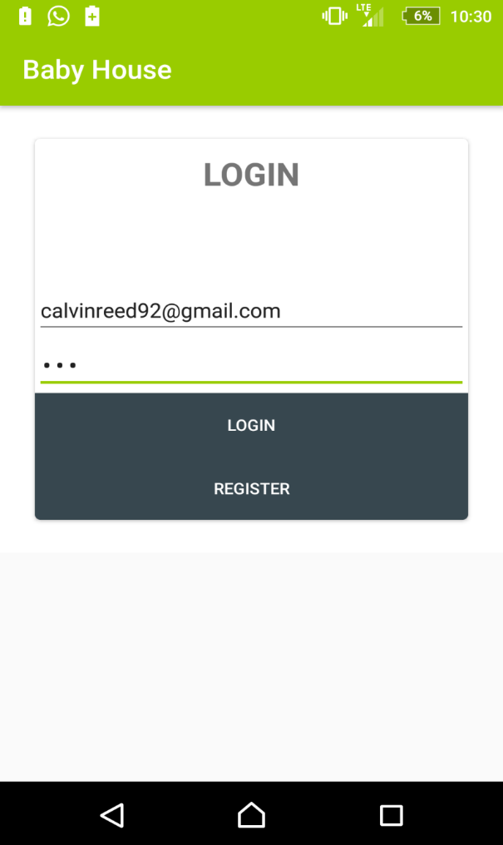
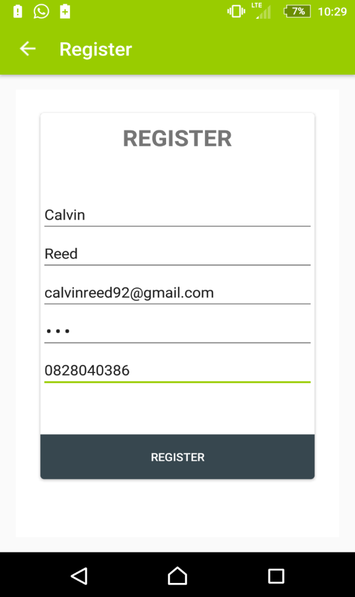
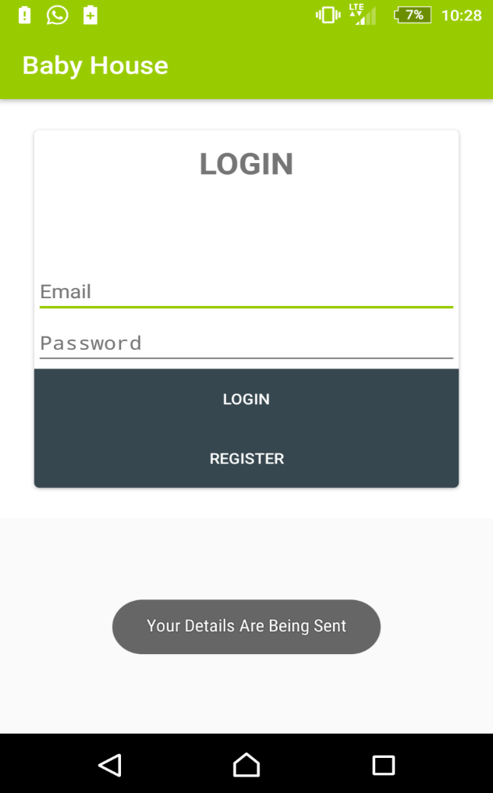
GUI – Android Login

Slide 16
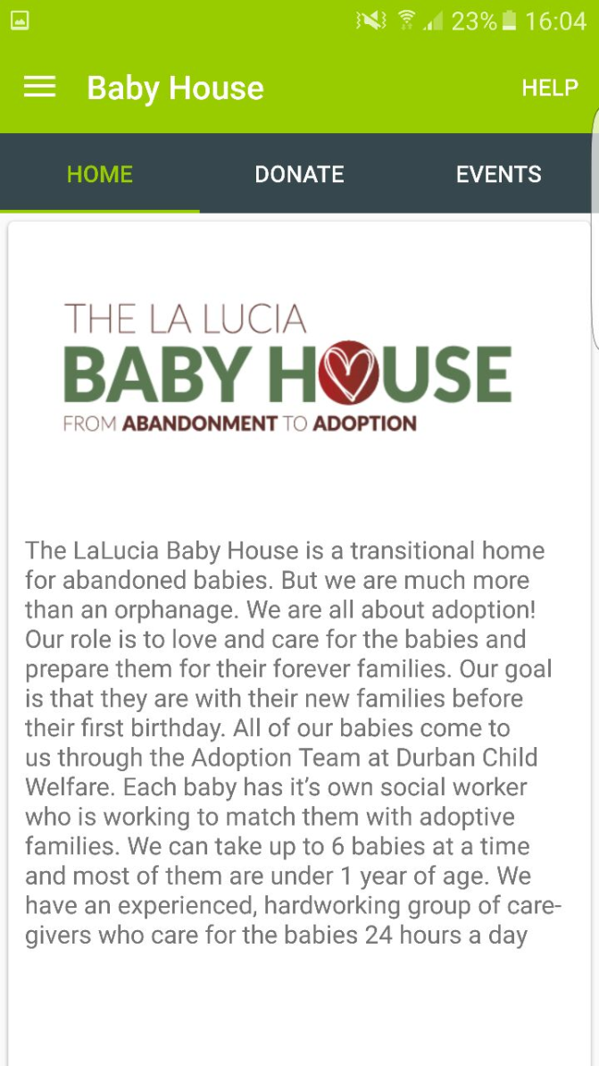
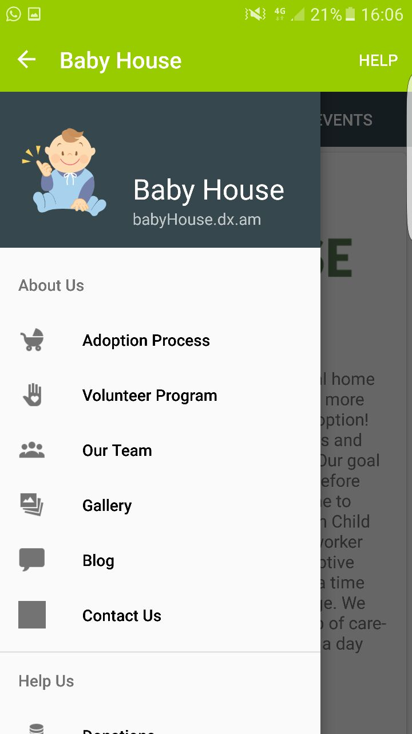
GUI – Home

Slide 17
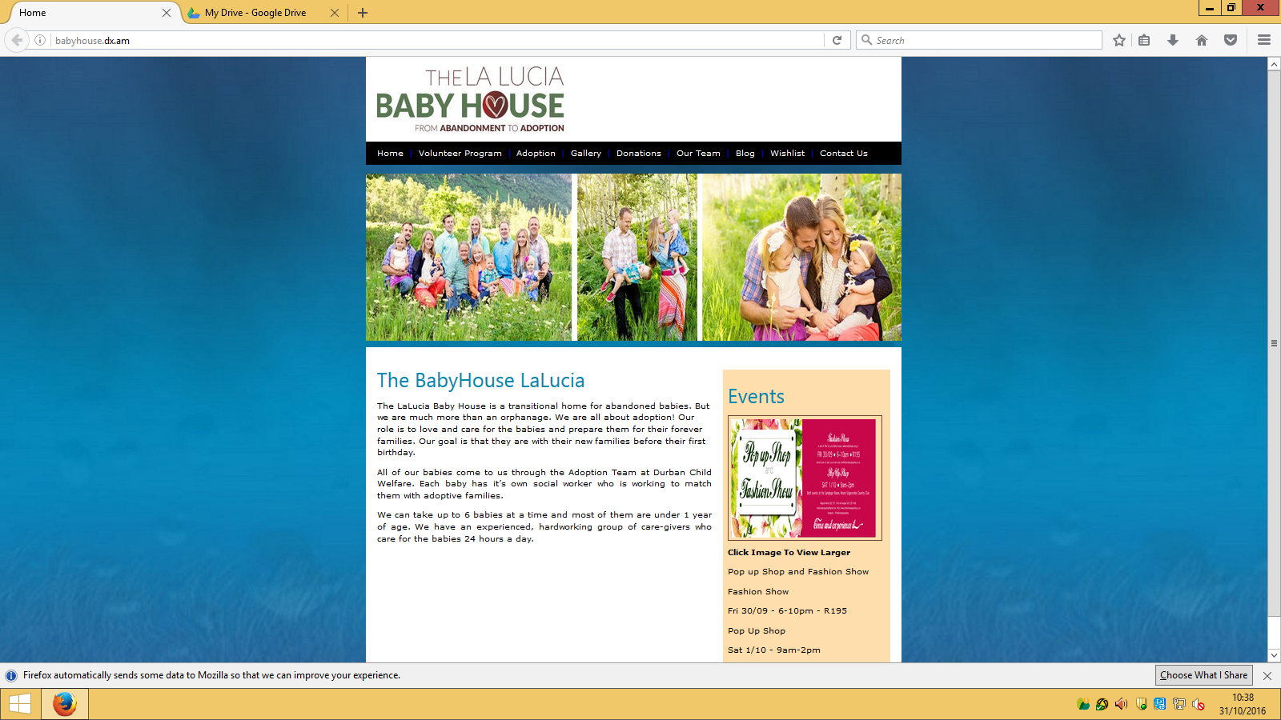
GUI – Website Home Page

Slide 18
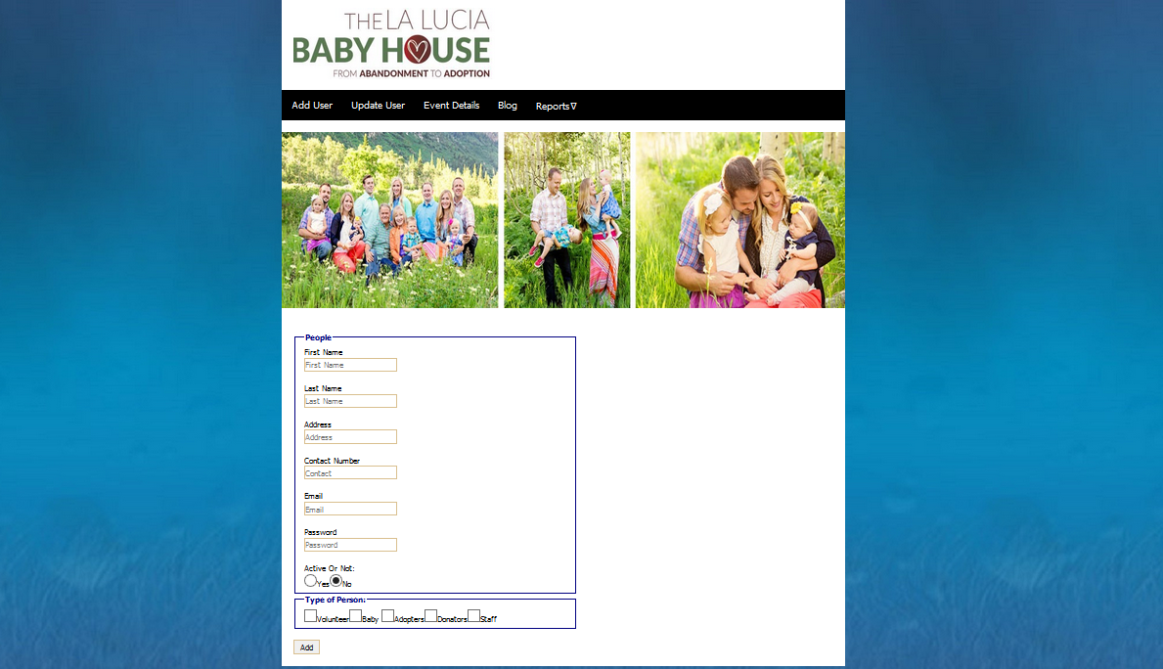
GUI – Website Admin Page

Slide 19

Mobile App + Website
(Demonstration)

Slide 20

Thank You

